Slide 1
Evaluating Performance of a Classiﬁer
How realistic is our observed success rate on a set of test data?
Construct a confidence interval such that the probability that the success rate on new data will lie within this interval is c
Would expect that as c increases, the width of the confidence interval will also increase

Slide 2
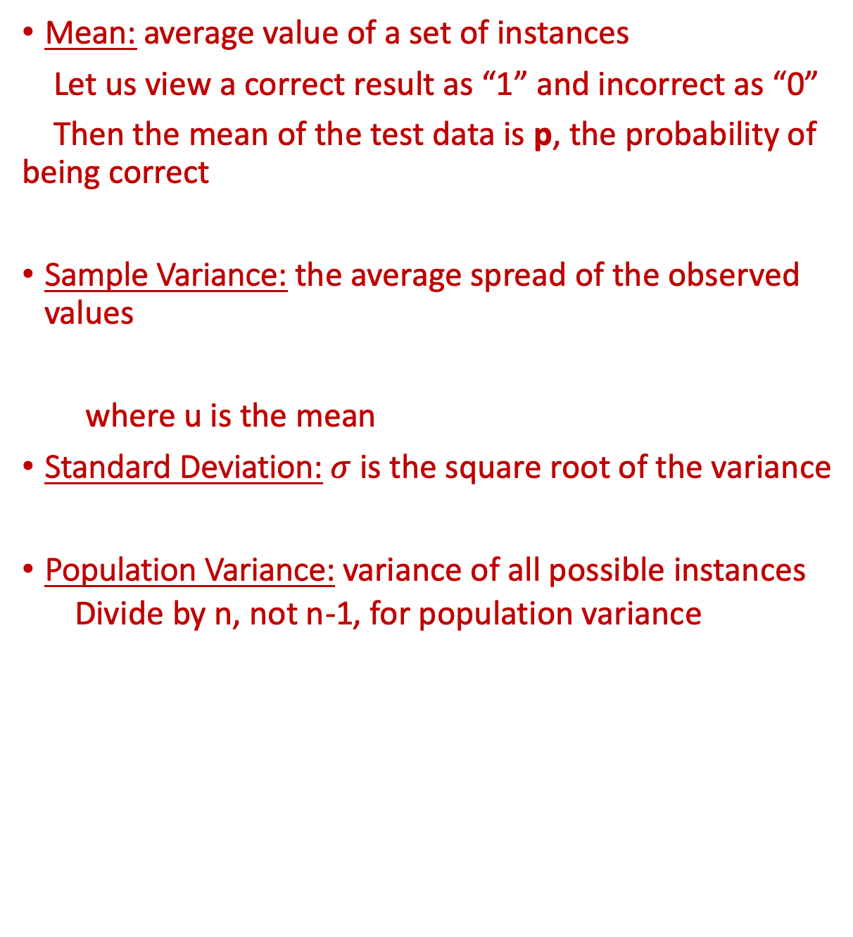
Statistical Background
Mean: average value of a set of instances
Let us view a correct result as “1” and incorrect as “0”
Then the mean of the test data is p, the probability of being correct
Sample Variance: the average spread of the observed values
where u is the mean
Standard Deviation: $σ$ is the square root of the variance
Population Variance: variance of all possible instances
Divide by n, not n-1, for population variance

Slide 3
Statistical Background
Variance is the expected value of (X_{i} – u)²
For a population,
***
where u is the mean and p_{i} is the probability of X_{i}
Let us again consider test data X_{i} that is either correct (1) or incorrect (0)
Then Variance =
(ValueOfCorrect – p)² * p + (ValueOfWrong – p)² * (1 –p)
= (1 – p)² * p + (0 – p)² * (1-p)
= p – p²
= p(1 – p)

Slide 4
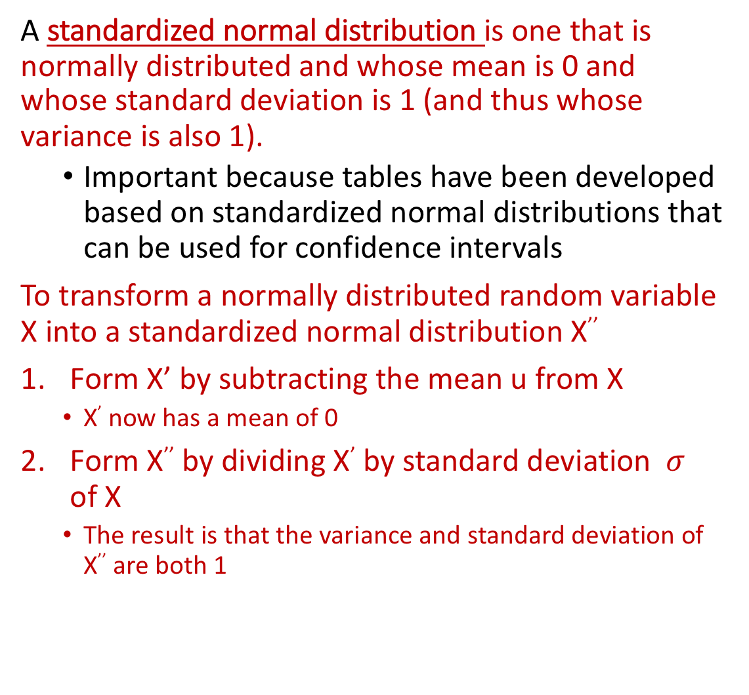
Statistical Background
A standardized normal distribution is one that is normally distributed and whose mean is 0 and whose standard deviation is 1 (and thus whose variance is also 1).
Important because tables have been developed based on standardized normal distributions that can be used for confidence intervals
To transform a normally distributed random variable X into a standardized normal distribution X’’
Form X’ by subtracting the mean u from X
X’ now has a mean of 0
Form X’’ by dividing X’ by standard deviation $σ$ of X
The result is that the variance and standard deviation of X’’ are both 1

Slide 5
Standardized Normal Distribution
Z is number of standard deviations

Slide 6
Table for Standardized Normal Distribution
https://www.mathsisfun.com/data/standard-normal-distribution-table.html
Entry in body of table gives the probability that 0$≤Z$

Slide 7
Table for Standardized Normal Distribution
Gives the probability c that a random variable with mean 0 and standard deviation 1 lies within the interval (0,Z)
Thus the probability that a random variable with mean 0 and standard deviation 1 lies within the interval (-Z,Z) is 2*c
If we want to know the probability that the standardized normally distributed random variable with mean 0 and standard deviation 1 lies within the interval (-Z,Z),
Find the value of Z in the table
Extract its associated probability from the body of the table
Multiply its associated probability by 2
Similarly, if we want to know the interval within which the standardized normally distributed variable will fall with probability c,
Divide c by 2
Look up the entry for c in the body of the table
Extract the associated Z value
The interval is (-Z,Z)

Slide 8
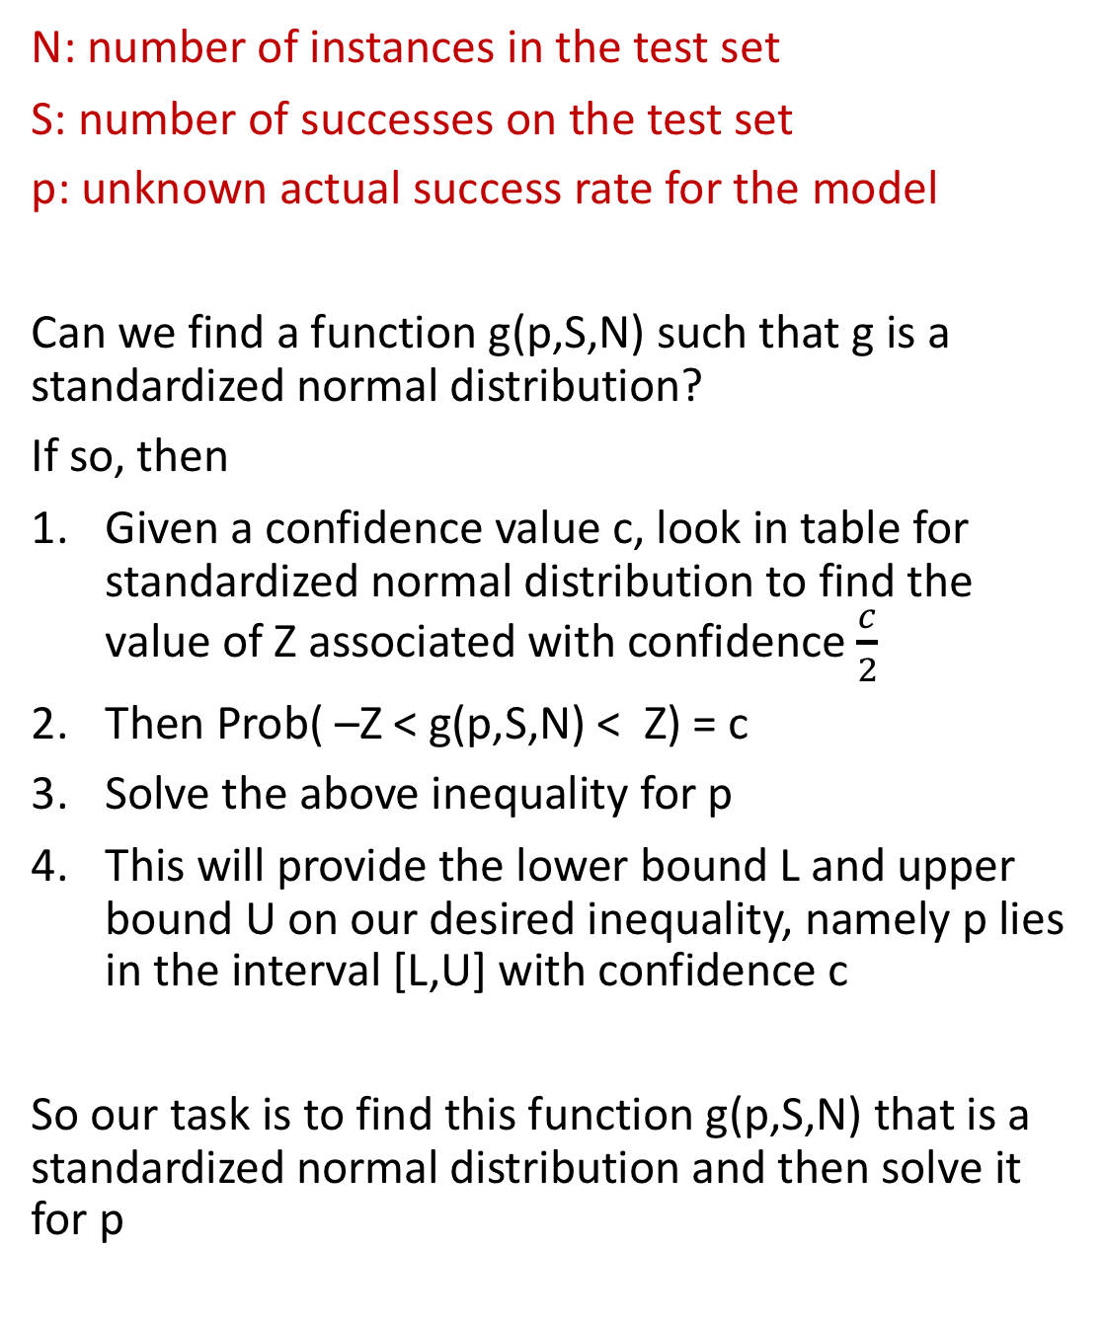
Confidence Interval for Success Rate
N: number of instances in the test set
S: number of successes on the test set
p: unknown actual success rate for the model
Can we find a function g(p,S,N) such that g is a standardized normal distribution?
If so, then
Given a confidence value c, look in table for standardized normal distribution to find the value of Z associated with confidence $\frac{c}{2}$
Then Prob( –Z < g(p,S,N) < Z) = c
Solve the above inequality for p
This will provide the lower bound L and upper bound U on our desired inequality, namely p lies in the interval [L,U] with confidence c
So our task is to find this function g(p,S,N) that is a standardized normal distribution and then solve it for p

Slide 9
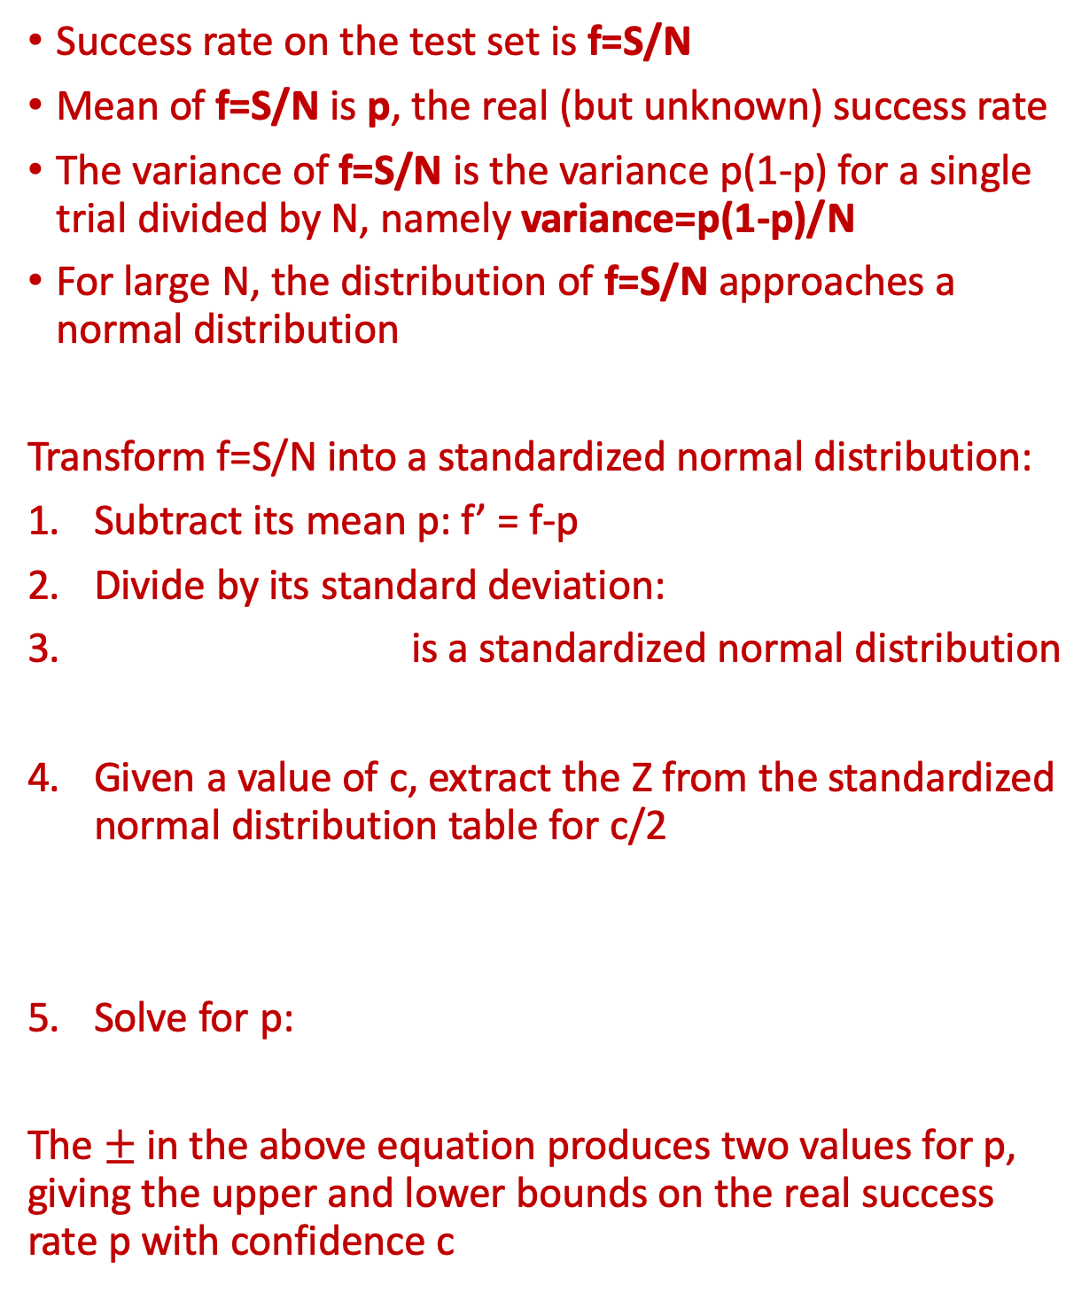
Confidence Interval for Success Rate
Success rate on the test set is f=S/N
Mean of f=S/N is p, the real (but unknown) success rate
The variance of f=S/N is the variance p(1-p) for a single trial divided by N, namely variance=p(1-p)/N
For large N, the distribution of f=S/N approaches a normal distribution
Transform f=S/N into a standardized normal distribution:
Subtract its mean p: f’ = f-p
Divide by its standard deviation:
is a standardized normal distribution
Given a value of c, extract the Z from the standardized normal distribution table for c/2
Solve for p:
The $±$ in the above equation produces two values for p, giving the upper and lower bounds on the real success rate p with confidence c

Slide 10
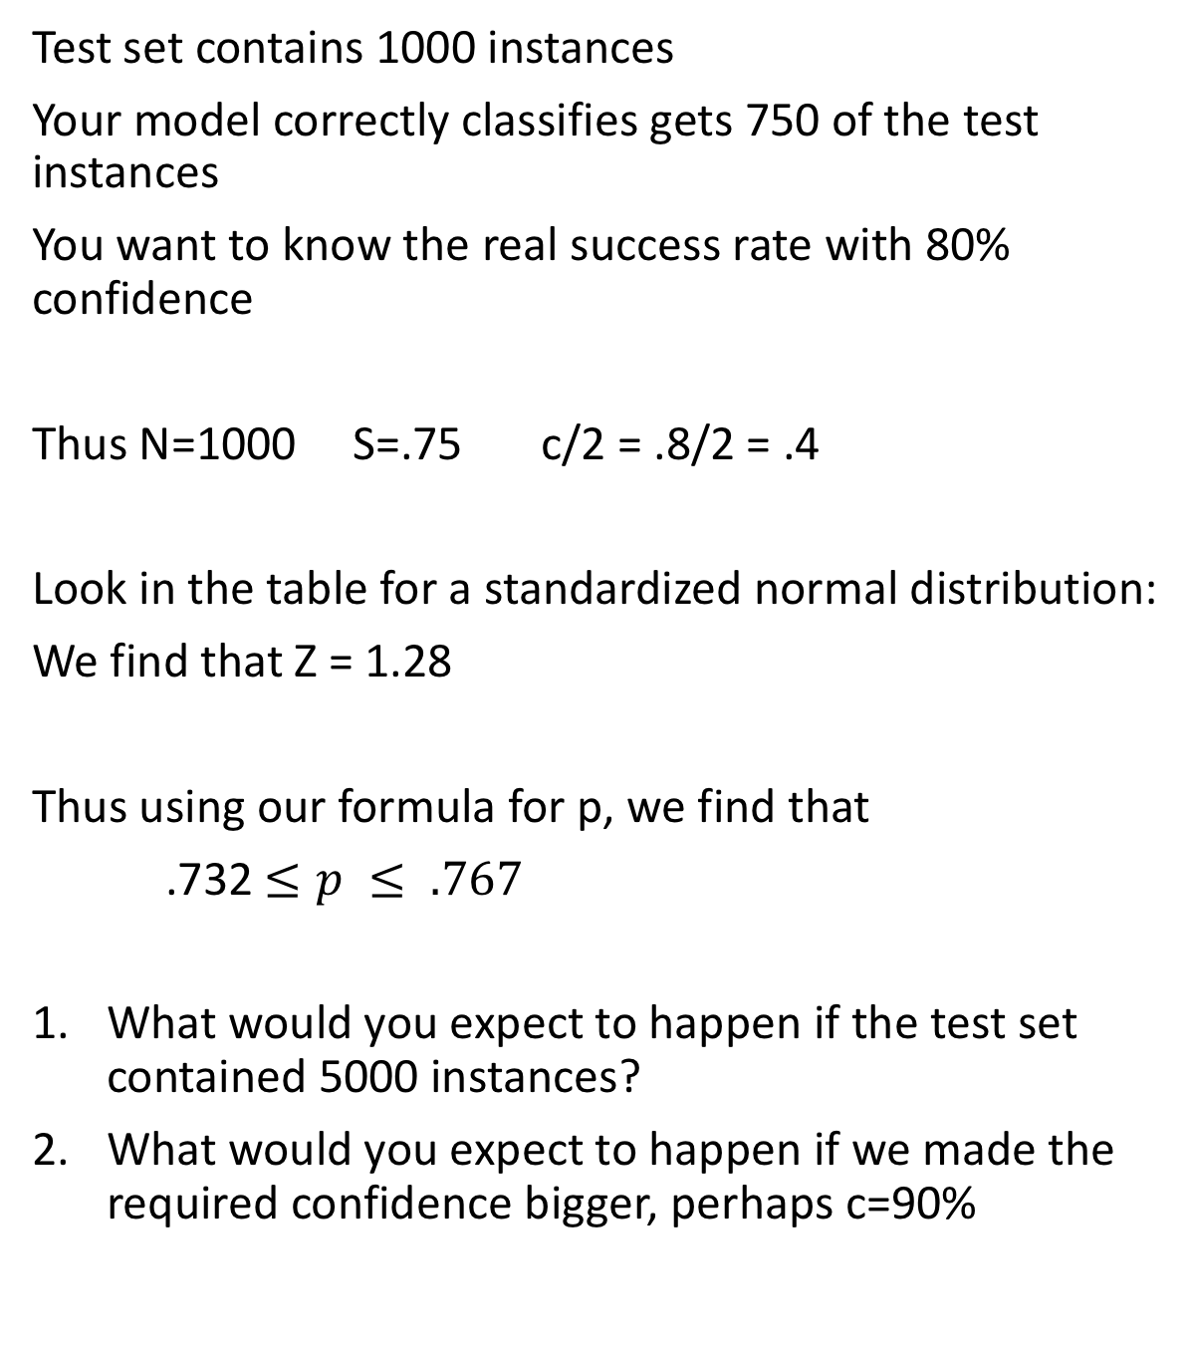
Example
Test set contains 1000 instances
Your model correctly classifies gets 750 of the test instances
You want to know the real success rate with 80% confidence
Thus N=1000 S=.75 c/2 = .8/2 = .4
Look in the table for a standardized normal distribution:
We find that Z = 1.28
Thus using our formula for p, we find that
.732 $≤p ≤ .767$
What would you expect to happen if the test set contained 5000 instances?
What would you expect to happen if we made the required confidence bigger, perhaps c=90%

